Slide 1
VAE: Rate-Distortion Curve & Aggregated Posterior
Presenter: Kim Seung Hwan (overnap@khu.ac.kr)

Slide 2
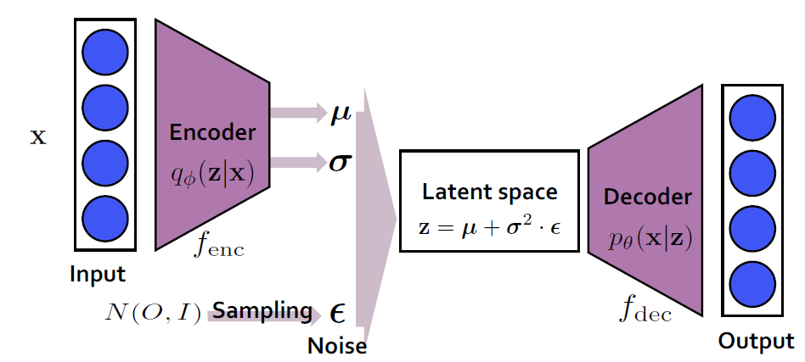

What is the Variational Autoencoder?
Deep Maximum Likelihood Model
Deep Latent Generative Model
An autoencoder with gaussian noise regularization (with some fine math support!)
A Decoder $p_{θ}(x|z)$ and a $q_{φ}\left(z | x\right)$ for a Data $x$ and its latent representation $z$
Kingma, Diederik P., and Max Welling. "Auto-encoding variational bayes." arXiv preprint arXiv:1312.6114 (2013).

Slide 3

Evidential Lower Bound?
Optimization target: ELBO (Evidence Lower Bound)
ELBO consists of the reconstruction term and regularization term
Since ELBO is the bound of the negative log-likelihood,
VAE can be viewed as a deep maximum likelihood model

Slide 4
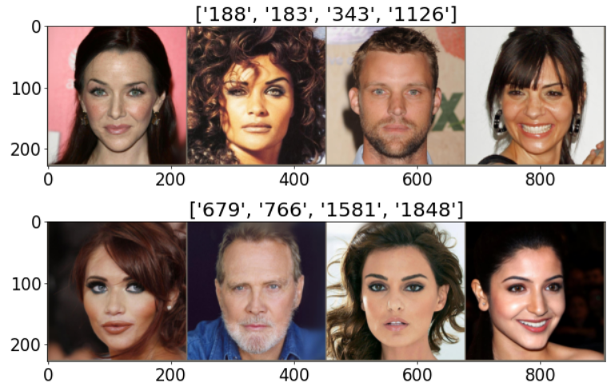
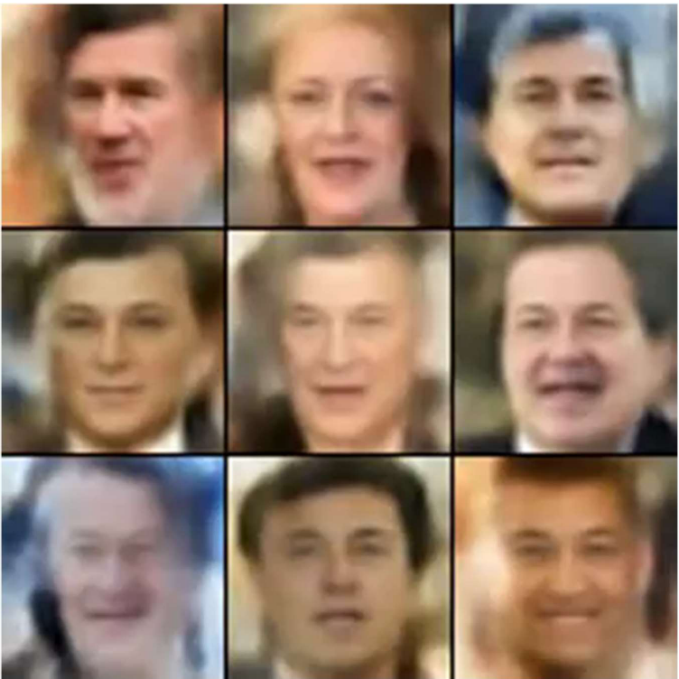
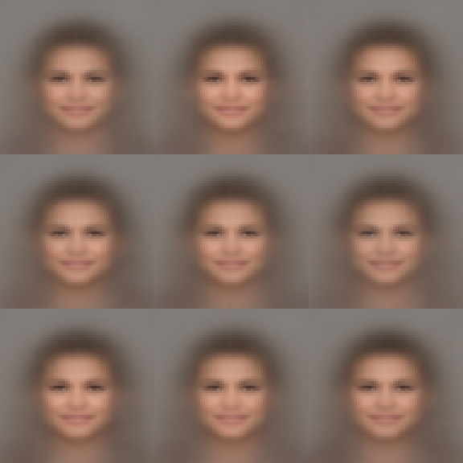
Pros and Cons of VAE
Pros
Solid mathematical background
Lightweight; simple structure and implementation (compared to the Diffusion)
No need adversarial strategy (compared to the GAN)
Low-dimensional latent variable
Cons
Posterior collapse (autodecoding-like behavior – always outputting the same)
Blurry output (bad reconstruction)
Poor sampling quality (samples from prior are noticeably worse than reconstruction)

Slide 5
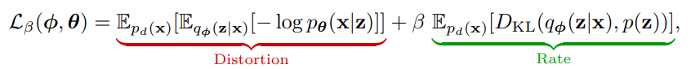
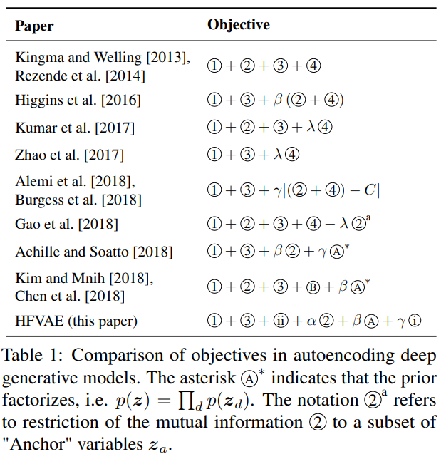
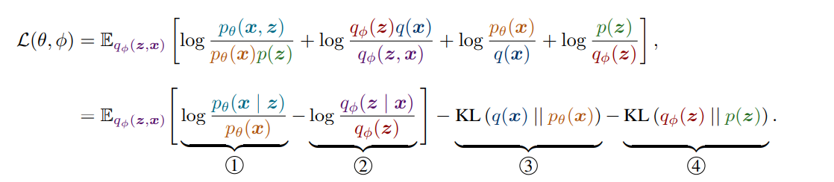

Blame the ELBO
Many VAE enhancements fix ELBO
$β$-VAE
And…
Higgins, Irina, et al. "beta-vae: Learning basic visual concepts with a constrained variational framework." International conference on learning representations. 2016.
Burgess, Christopher P., et al. "Understanding disentangling in $\beta $-VAE." arXiv preprint arXiv:1804.03599 (2018).

Slide 6
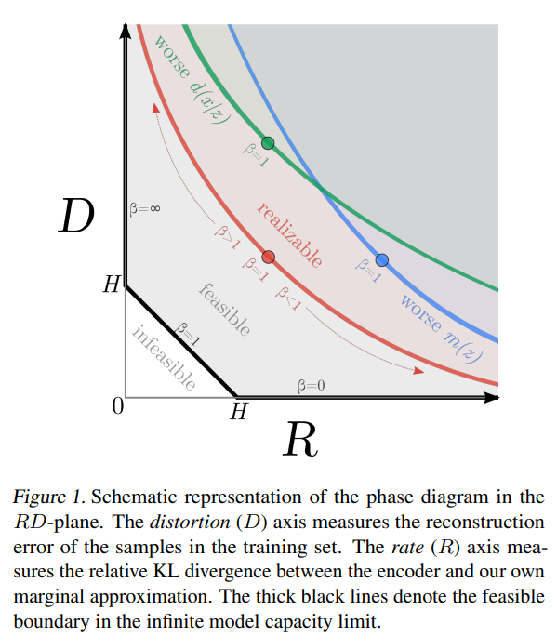
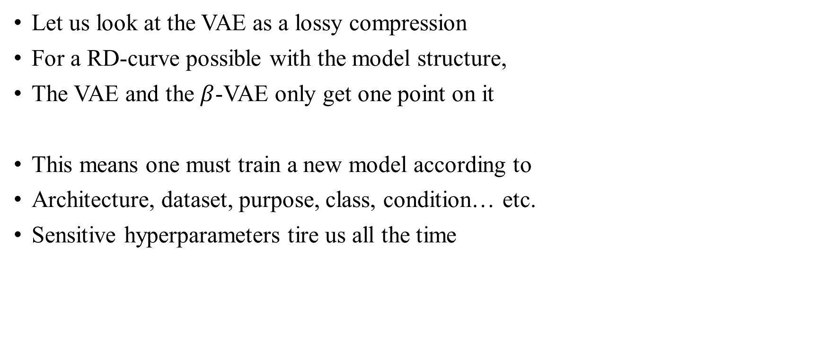
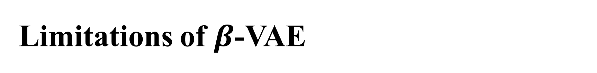
Limitations of $β$-VAE
Let us look at the VAE as a lossy compression
For a RD-curve possible with the model structure,
The VAE and the $β$-VAE only get one point on it
This means one must train a new model according to
Architecture, dataset, purpose, class, condition… etc.
Sensitive hyperparameters tire us all the time
Alemi, Alexander, et al. "Fixing a broken ELBO." International conference on machine learning. PMLR, 2018.

Slide 7
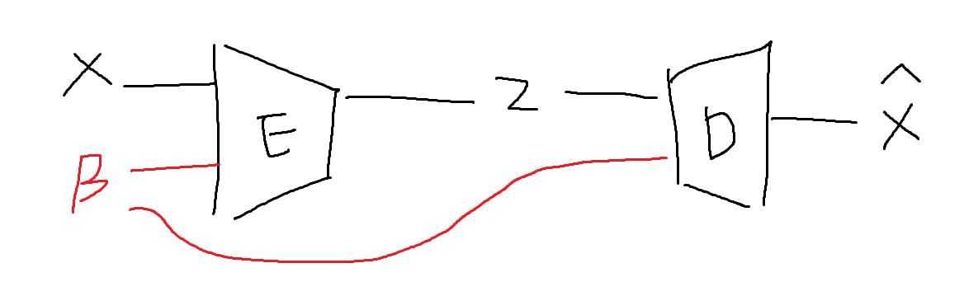
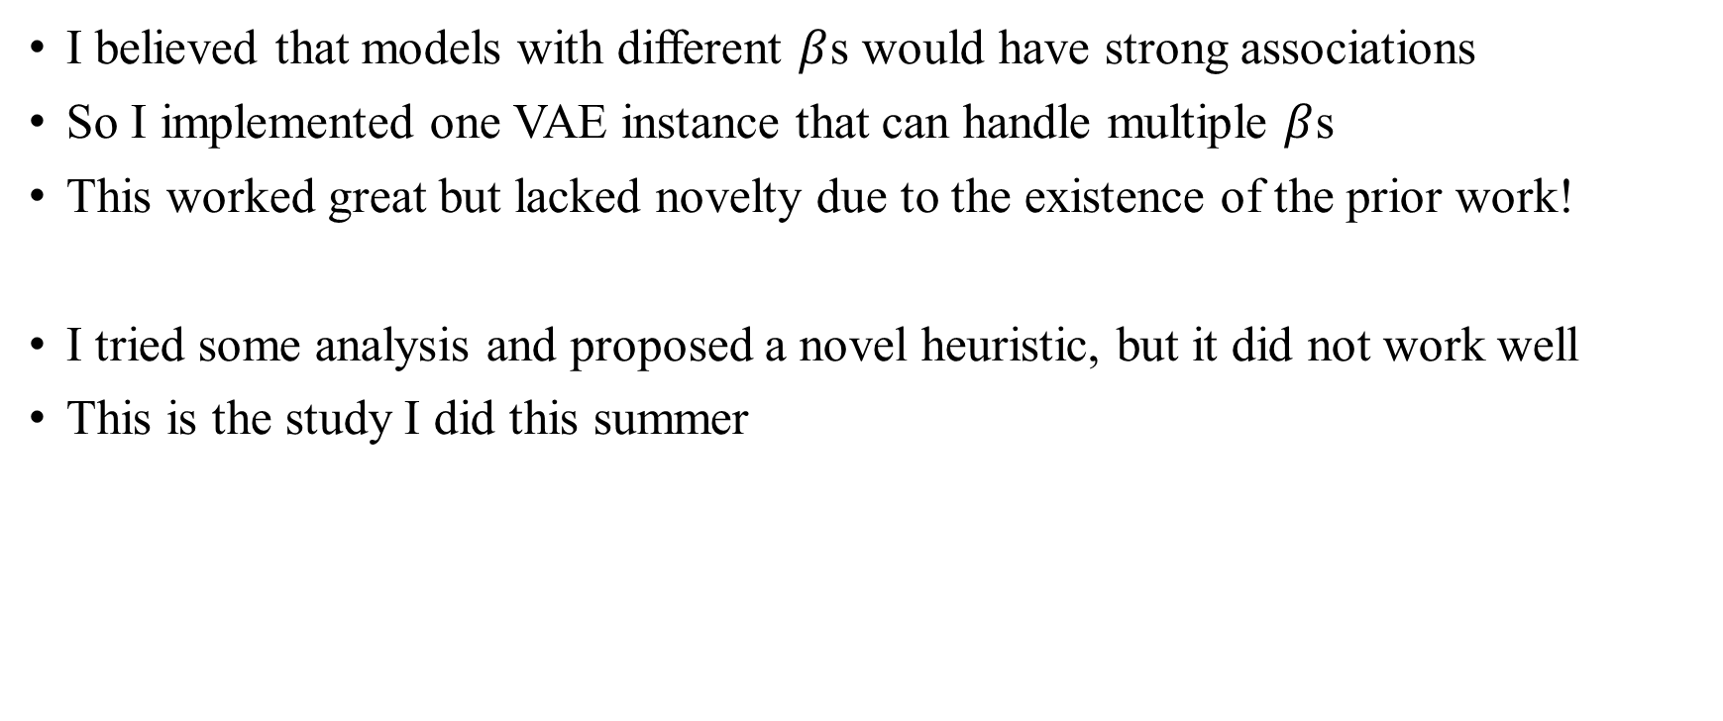
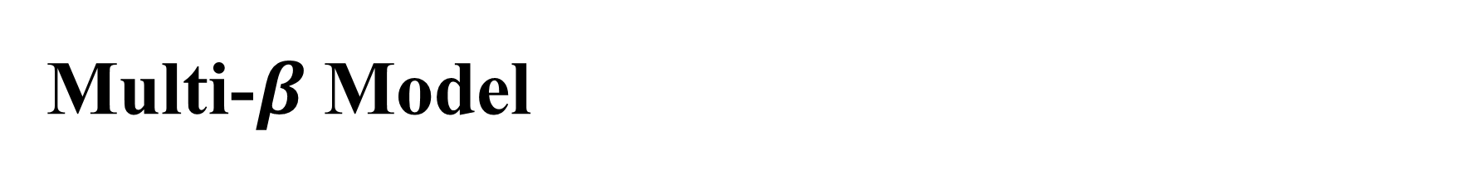
Multi-$β$ Model
I believed that models with different $β$s would have strong associations
So I implemented one VAE instance that can handle multiple $β$s
This worked great but lacked novelty due to the existence of the prior work!
I tried some analysis and proposed a novel heuristic, but it did not work well
This is the study I did this summer

Slide 8
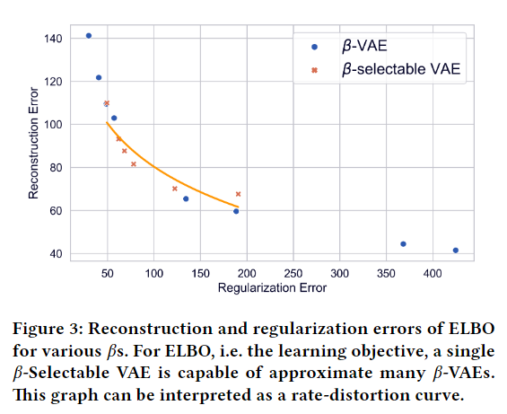
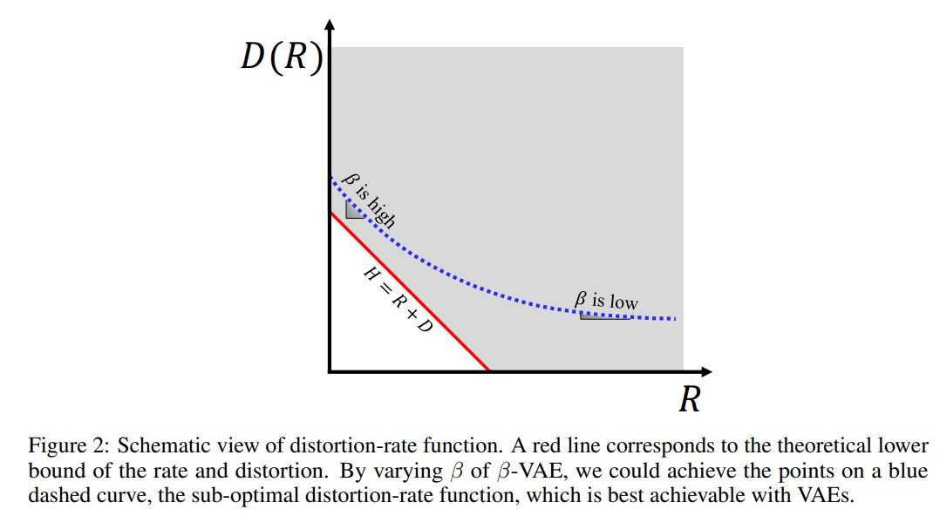
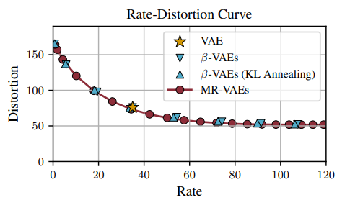
Rate-Distortion Curve
This is the achieved RD-Curve, and the right side is from the references
Why are these in log-like form?
Bae, Juhan, et al. "Multi-Rate VAE: Train Once, Get the Full Rate-Distortion Curve." The Eleventh International Conference on Learning Representations. 2022. Seonho, George Adosoglou, and Panos M. Pardalos. "Interpreting rate-distortion of variational autoencoder and using model uncertainty for anomaly detection." Annals of Mathematics and Artificial Intelligence 90.7-9 (2022): 735-752.

Slide 9
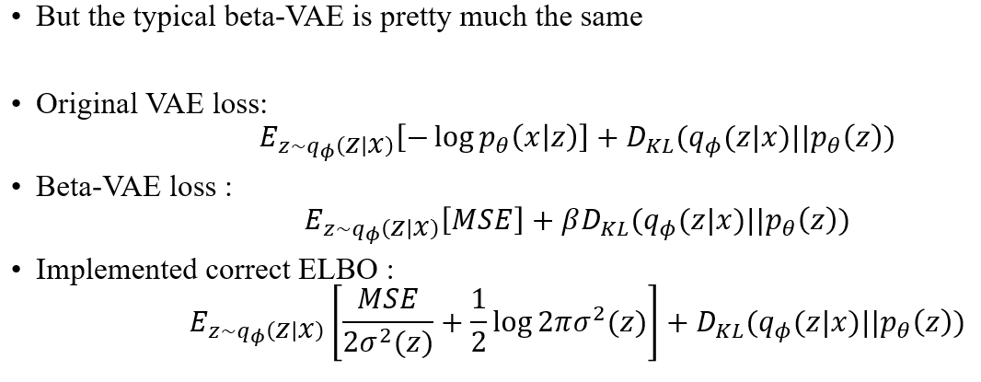

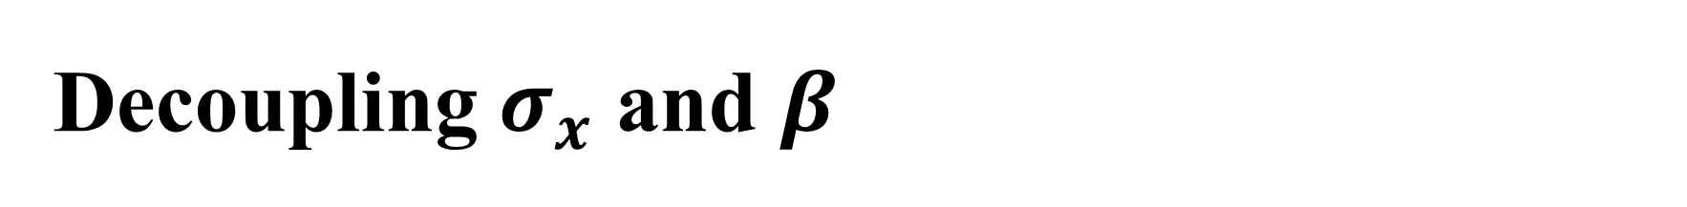
Decoupling $σ_{x}$ and $β$
The $β$-VAE has been popular and there are numerous analyses on it
What I doubt is how they dealt with the variance of the decoder $σ_{x}$
In terms of formula, $σ_{x}(z)$ has a similar meaning to $β$
The difference is that the $σ_{x}$ itself remains the likelihood

Slide 10

Decoupling $σ_{x}$ and $β$
Many implementations keep $σ_{x}$ constant and exclude it from optimization
My claim is: studies so far have mixed the effects of $σ_{x}$ and $β$
Separating these explicitly will make the effect of each clearer
This is the first research direction

Slide 11

Decoupling $σ_{x}$ and $β$
Perhaps the analytically optimal $σ_{x}=√MSE$ works
In this case, the reconstruction term becomes $\log{MSE}$
The toy example had an unusual result: it has linear RD-Curve…?

Slide 12
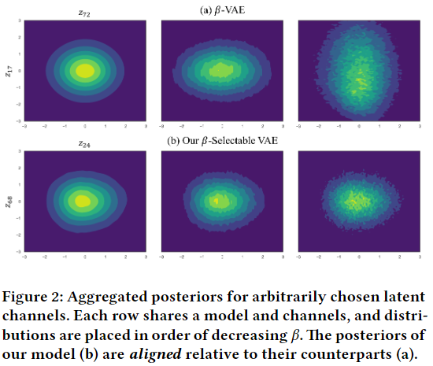

Aggregated Posterior
This means $q_{φ}\left(z\right)=\frac{1}{N}\sum_{x}^{N}{q_{φ}(z|x)}$
Sampling would be good if $q_{φ}\left(z\right)≈p\left(z\right)$
In general, as $β$ increases,
i.e. the regularization term decreases,
The above property is satisfied
But the shape of the posterior is different
For the same Rate…?

Slide 13
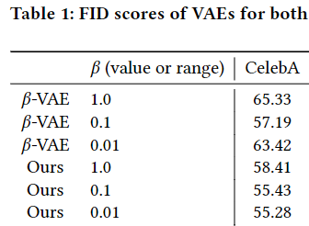
Aggregated Posterior
If this is theoretically true, RD-Curve will not be able to express all of VAEs
A new axis for some “sampling ease” should be added
The candidate emerges from the decomposition mentioned earlier
This is the second research direction
Alemi, Alexander, et al. "Fixing a broken ELBO." International conference on machine learning. PMLR, 2018.
Burgess, Christopher P., et al. "Understanding disentangling in $\beta $-VAE." arXiv preprint arXiv:1804.03599 (2018).

Slide 14
Aggregated Posterior
I might find a practical use for the observation: the posteriors are aligned
The recursive heuristic I tried would be one of them (albeit with bad results)
It is an interesting property, but I do not know how to utilize it
This may be the third research direction

Slide 15

Thank you for listening
Presenter: Kim Seung Hwan (overnap@khu.ac.kr)

